Slide 1

CT216 Project
Polar Codes
From Theory to 5G: The Power of Polarization

Slide 2




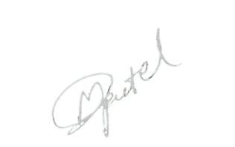
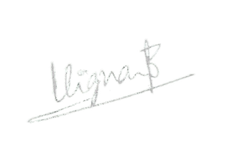
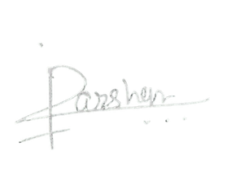




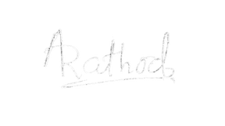
Honor code
We declare that
→ The work that we are presenting is our own work.
→ We have not copied the work (the code, the results, etc.)
that someone else has done.
→ Concepts, understanding and insights we will be describing
are our own.
→ We make this pledge truthfully. We know that violation of this
solemn pledge can carry grave consequences.
Rushi
202301156
Parv Khetawat
202301157
Manav
202301158
Dip
202301159
Viswa Vignan
202301160
Darshan
202301161
Mitwa
202301162
Aryan
202301164
Shrey Shah
202301165
Rishit
202301167

Slide 3

Polar
Codes
Introduction to Polar Codes
Uses of Polar Codes
How does Channel gets Polarized?
Encoding in Polar Codes
Decoding:
Successive Cancelation Decoder
Successive Cancelation List Decoder
Performance Demonstration

Slide 4
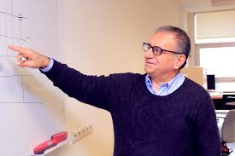
Intoduction
Polar codes were introduced by Erdal Arikan in 2008.
These codes play a vital role in Information Theory, they are linear error-correcting codes that recursively give output according to data fed to them. It is a Symmetric Binary-Input Discrete Memoryless Channel (BDMC).
Polar Codes are sequential in nature.
By using this we can highly elevate the data transfer capacity of the channel to get close to Shannon Capacity, which is the theoretical limit, which sets the bar for the maximum rate for a given bandwidth and a given noise level.
Erdal Arikan
at Bilkent university

Slide 5
Uses of polar code
5G Communication Systems
Polar codes are expected to play a crucial role in 5G and beyond communication systems. They are well-suited for the next-generation mobile communication standards due to their capacity.
2. Wireless Communication
Polar codes are well-suited for various wireless communication standards, including
Wi-Fi, Bluetooth, and other short-range wireless technologies.

Slide 6



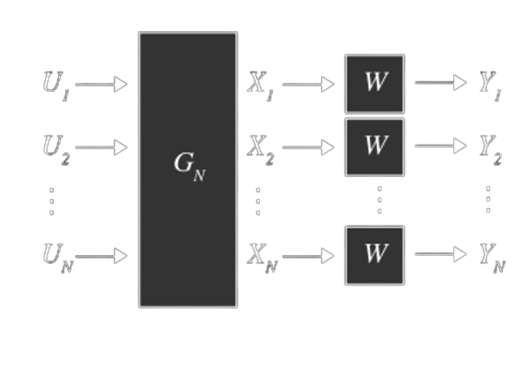
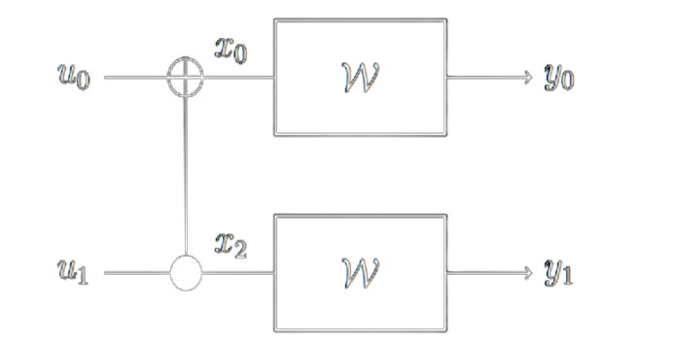
Channel Polarization
Polar Codes work by transforming a noisy communication channel into two sub-channels: one with high reliability and the other with low reliability. This process is known as channel polarization.
B-DMC With Two-Fold Polarization
Polarization of W into N virtual channels

Slide 7
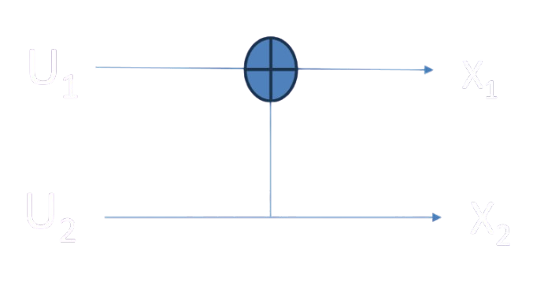

Basic 2 cross 2 Transformation
U1, U2, X1, X2 ∈{0,1} Binary Variables
Equivalently X1 =U1 ⨁ U2 and X2 = U2

Slide 8

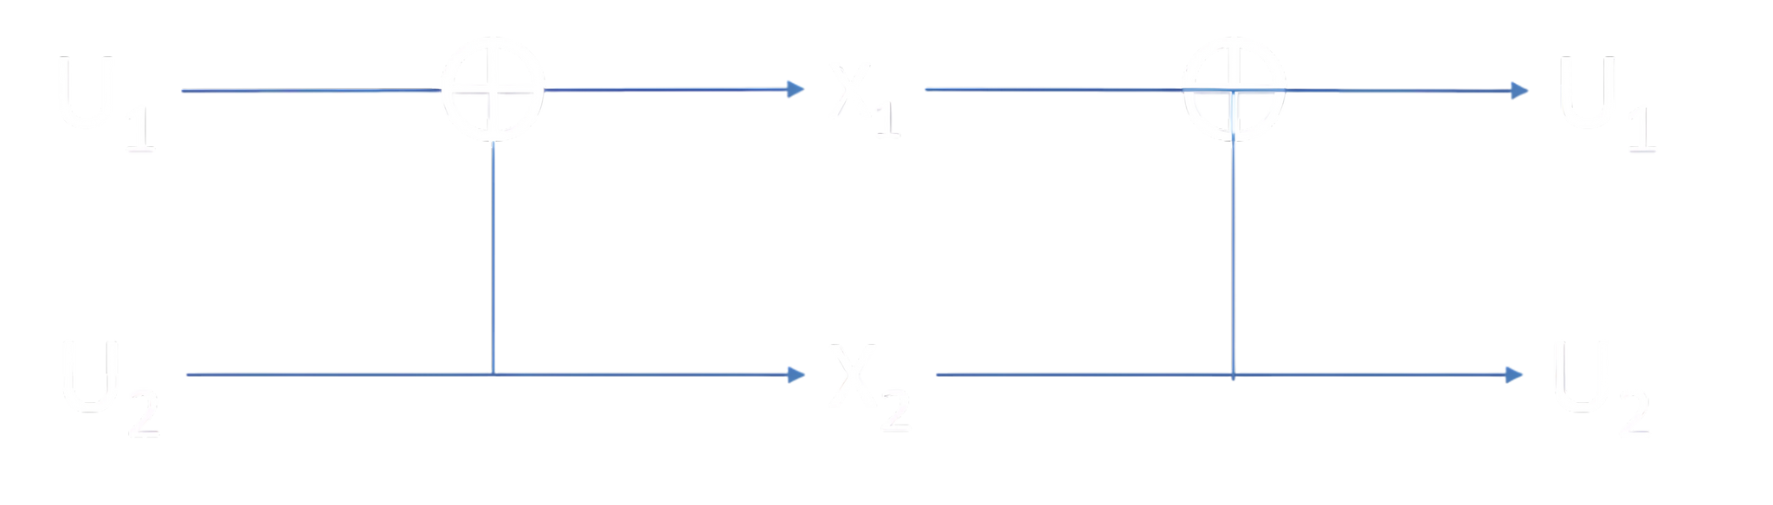
Properties of G22

Slide 9
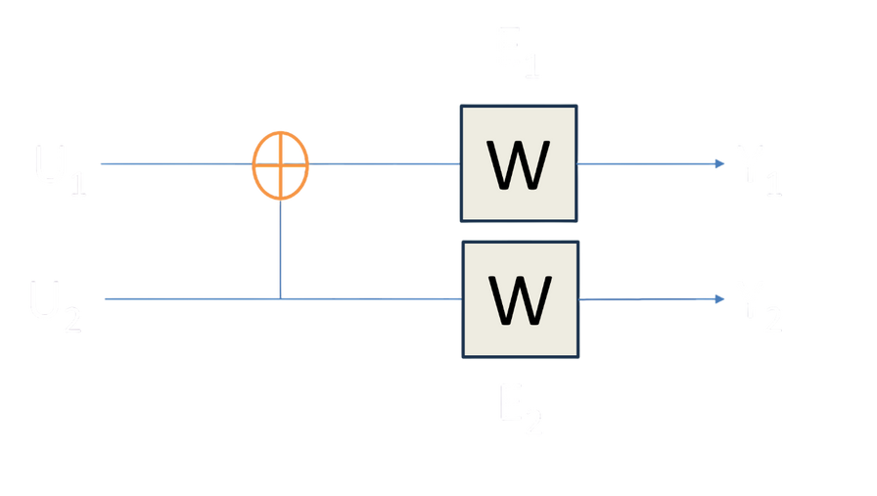
Channel Polarization
In Sequential Decoding, First bit channel
If Y1 is Erased U1 is Erased.
If Y2 is Erased U1 is Erased.
It means as,
U1 is Erased If (E1 or E2).
P(E1 or E2) = 2∈ - ∈2
Second bit channel,
If Y1 and Y2 are Erased, U2 is Erased.
It means as,
U2 is Erased If (E1 and E2).
P(E1 and E2) = ∈2

Slide 10
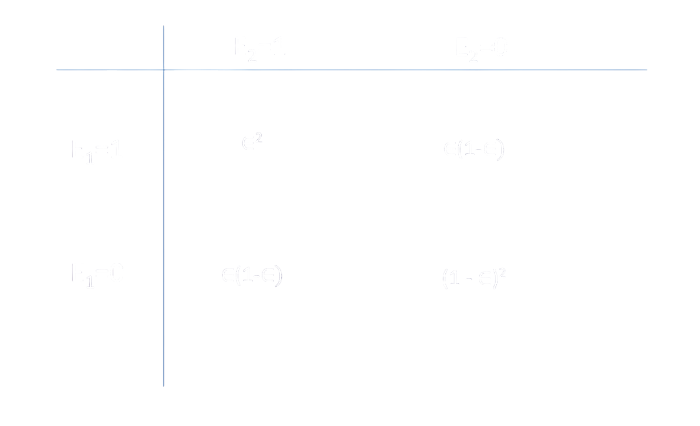
Channel Polarization

Slide 11
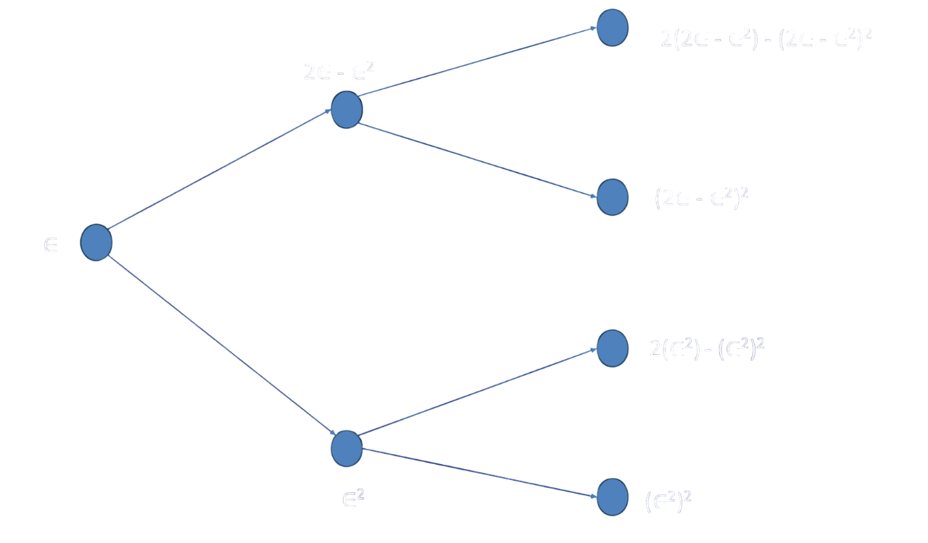
Channel Polarization

Slide 12
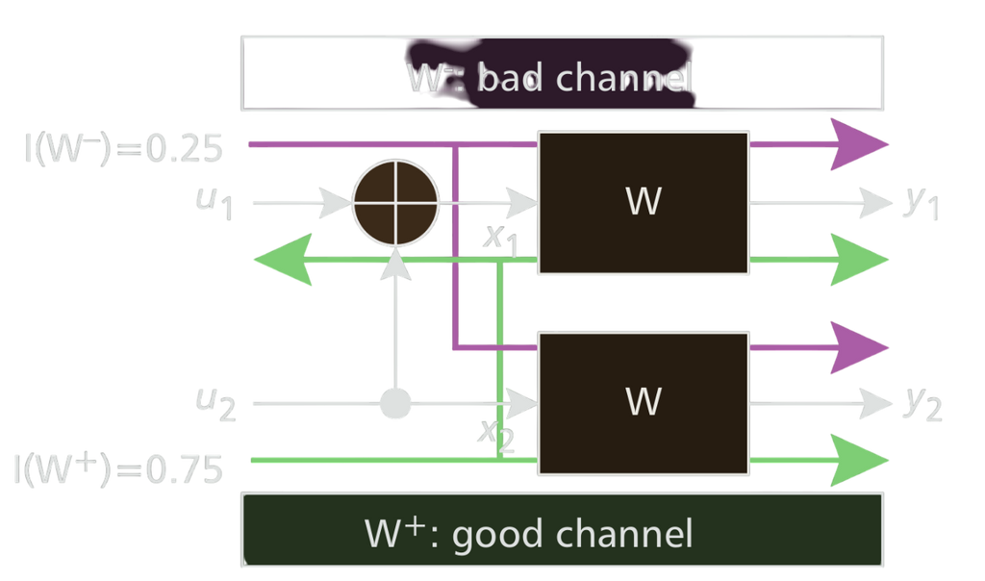
Channel Polarization
W- : Bad Channel
W+ : Good Channel
Combining two independent uses of this BEC, a compound channel (W, W) is obtained which has two input bits X1, X2, and two output bits Y1, Y2. an Associated capacity is 2I(W).
Two independent BECs can be combined into one Equivalent Compound channel with same output bits(Y1,Y2) and two input bits(U1, U2).This can be done by performing a single modulo-2 operation.
The capacity of this channel Remain same 2I(W). (Invertible transformation does not alter capacity)

Slide 13
Reliability Sequence
Polar coding is based on the phenomenon called channel polarisation (hence the name 'polar' codes) as discussed previously.​
Polar codes work by combining multiple identical copies of a communication channel in a structured way.​
As the number of copies goes to infinity, a fraction becomes ultrareliable and others become unreliable (extremal channels). ​
Think of it like filtering stones from sand — at first everything is mixed, but as you keep filtering (combining and splitting channels), you end up with two clear groups: pure stones (goodchannels) and pure sand (bad channels).​
The problem, in general, is there is no low-complexity algo for obtaining the bit channel reliability except for the Binary Erasure Channel (BEC) with a linear complexity O(N).​

Slide 14
Reliability Sequence
The Reliability Sequence in Polar Codes refers to a precomputed ordering of bit-channel indices based on their reliability (i.e., how likely they are to correctly carry information after polarization).
It is used to determine which bit-channels should be used to transmit information bits (the most reliable ones) and which should be assigned frozen bits (the least reliable ones), typically set to zero to assist in decoding.
Reliability Sequence For N=8
1 2 3 5 4 6 7 8
Reliability Sequence For N=16
1 2 3 5 9 4 6 10 7 11 13 8 12 14 15 16

Slide 15


Bhattacharyya Parameter
Defined as ‘A measure of how unreliable or confusing a communication channel is’ and is given as
W(Y|X) is the probability of the output Y given the input X.
when W(Y|0) = W(Y|1)
Both the probabilities are equal hence the channel is confused because it does not know where the output came from (UNRELIABLE)
When W(Y|0) ≠ W(Y|1)
This means that there is no confusion from where the output came.
Bhattacharyya parameter gives a single number on how reliable the channel is.
Simple intuition is that
Z(W) = 0 then the channel is perfect.
Z(W) = 1 then the channel is perfectly noisy.
This means that lower the value more reliable the channel is.

Slide 16
Bhattacharyya Parameter
For the BEC Z(W) = ∈ (probability of erasure)
As already stated the channel is divided as W+ and W-.
W+ - used to decode u2
W- - used to decode u1
From the tree, we can get to the conclusion that
Z(W-) = 2Z(W) - Z(W)2 = 2∈ - ∈2
Z(W+) = Z(W)2 = ∈2
Recursively as shown in the diagram we can find the Bhattacharyya parameter as we keep on splitting them.
This results in Matthew effect: the good become better and the bad become worse.

Slide 17
Bhattacharyya Parameter
So after channel combining and channel splitting, two independent BECs with the same reliability are transformed into two polarized channels and the sum capacity of two channels is unchangeable, that is,
I(W-) + I(W+) = 2I(W).
We know that I(W)=1 - ∈, I(W+) =1 - ∈2 and I(W-) = (1 - ∈)2
Arikan derived the mutual information of the two channels as
I(W+) = 2I(W) – I(W)2
I(W-) = I(W)2
W- has a smaller capacity than the given BEC W and W+ has a larger capacity
that is, I(W-) ≤ I(W) ≤ I(W+).

Slide 18
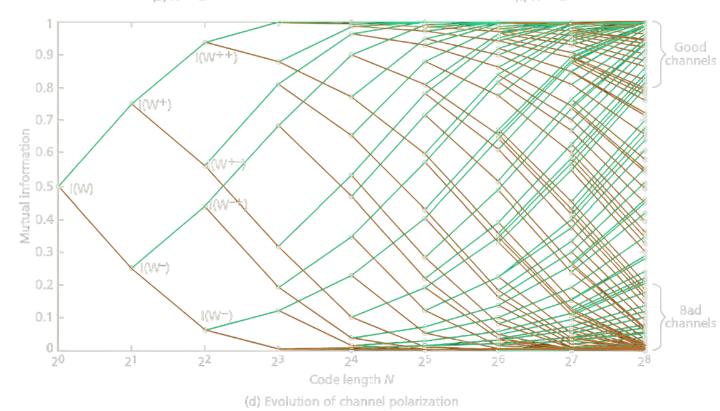
Bhattacharyya Parameter
The Capacities of each polarized channel can be recursively Evaluated and the polarising transformations can be carried out continuously over N = 2n independent uses of given BEC.
Polarization effect continuously improves with increased code length N.
The capability of majority of polarized channel tends to either 1 (Good Channel with little noise) or 0 (bad channel with full noise).
The polarised channels under the Matthew effect move to two extremes as the code length N approaches to infinity(the associated capacity is 0 or 1.

Slide 19
Algo. for relaibility seq.
global var index = 1 //keeps track of how many channels have been processed so far
// N = total number of bit channels (a power of 2)
// m : to store the error probability and the corresponding index
» define N, map(double, int) m, i = 0 //i: initial depth level for the recursion
n = log2N
p = Q(SNR) //probability p represents how noisy the channel is before polarization.
split(m, p, index, i)
reliability sequence = m.values
define function split(m, p, index, i)
if (i == n ∨ index == N) //Stop the recursion if you've reached the maximum depth n
m[p] = index //Store the current error probability p with the current index in the map m.
index = index + 1
return
split(m, 2p − p^2, index, i + 1)
split(m, p^2, index, i + 1)
return

Slide 20
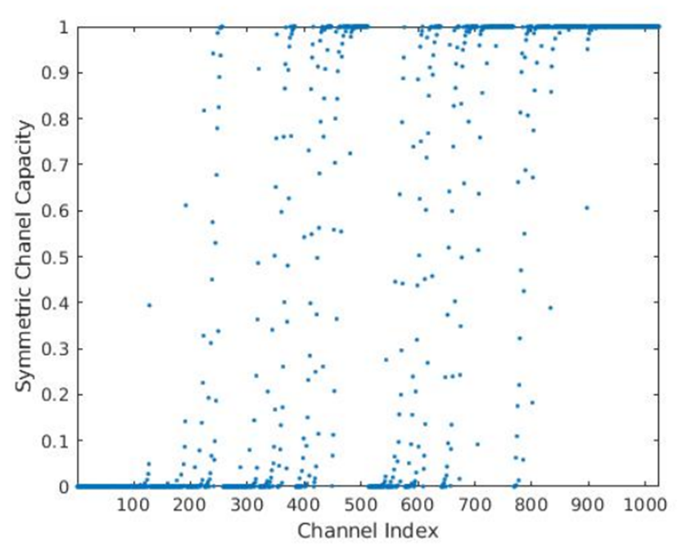
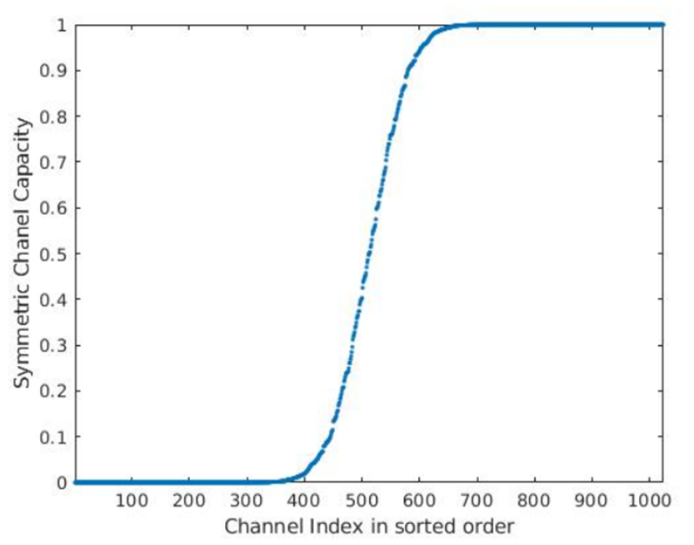
Effect of Channel Polarization on Information
Polar codes gives either completely perfect channel or extremely noisy channel.
The middle part vanishes as N tends to infinity and becomes a step function.

Slide 21
Encoding

Slide 22

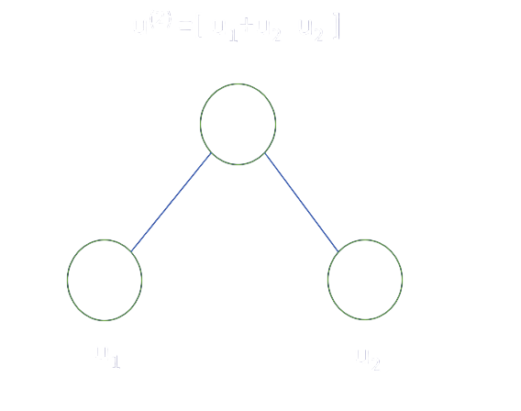
Encoding
Polar Transform: G2
Matrix Representation
Binary Tree Representation

Slide 23

Encoding
Polar Transform: G4
Matrix Representation
Kronecker Multiplication

Slide 24
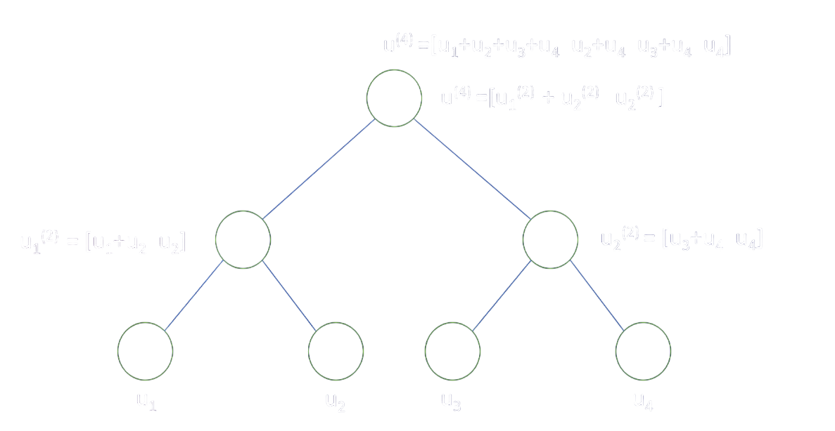
Encoding
Polar Transform: G2
Binary Tree Representation

Slide 25

Encoding
Polar Transform: General
Matrix Representation
Binary Tree Representation

Slide 26
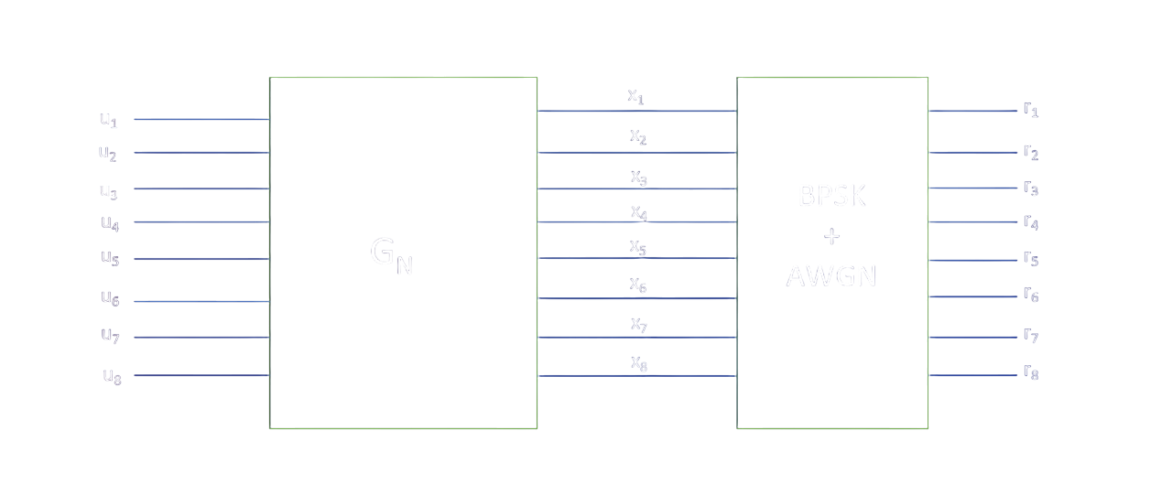

Polar Transform & BPSK-AWGN
BPSK
+
AWGN

Slide 27
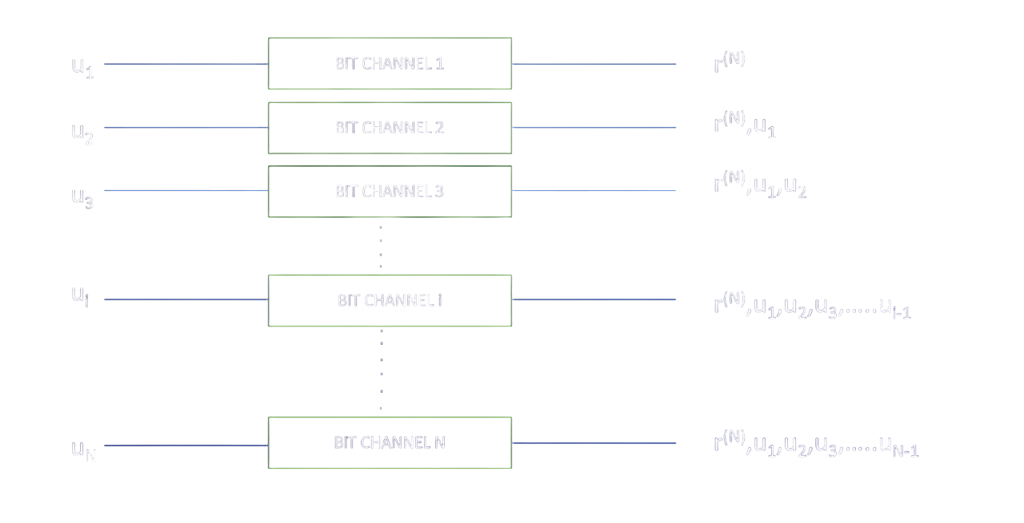
Encoding
Bit Channel 1
Bit Channel 2
Bit Channel 3
Bit Channel i
Bit Channel N

Slide 28
(N,K) Polar Code
Mathematical Description of (N,K) Polar Codes
Parameters:
N : Length of the Codeword
K : Number of information bits per Codeword
R : Code Rate (R = K/N , 0 ≤ R ≤ 1)
GN: Bit Reversal Matrix or Kernel Matrix
Encoding Process:
Input Vector : u = [ u1, u2, u3, …, uN]
Partitioning : Divide u into K information bits and N - K frozen bits (least reliable(worst) Channels from Reliability sequence).
Frozen Bits : These Bits are typically set to fixed value 0 and Do not carry any information.
Message Bits(m): These Bits refer to actual Data or Information Bits that are being transmitted over a communication channel. Remaining K bits of u.
Codeword calculation:
Codeword : uGn

Slide 29
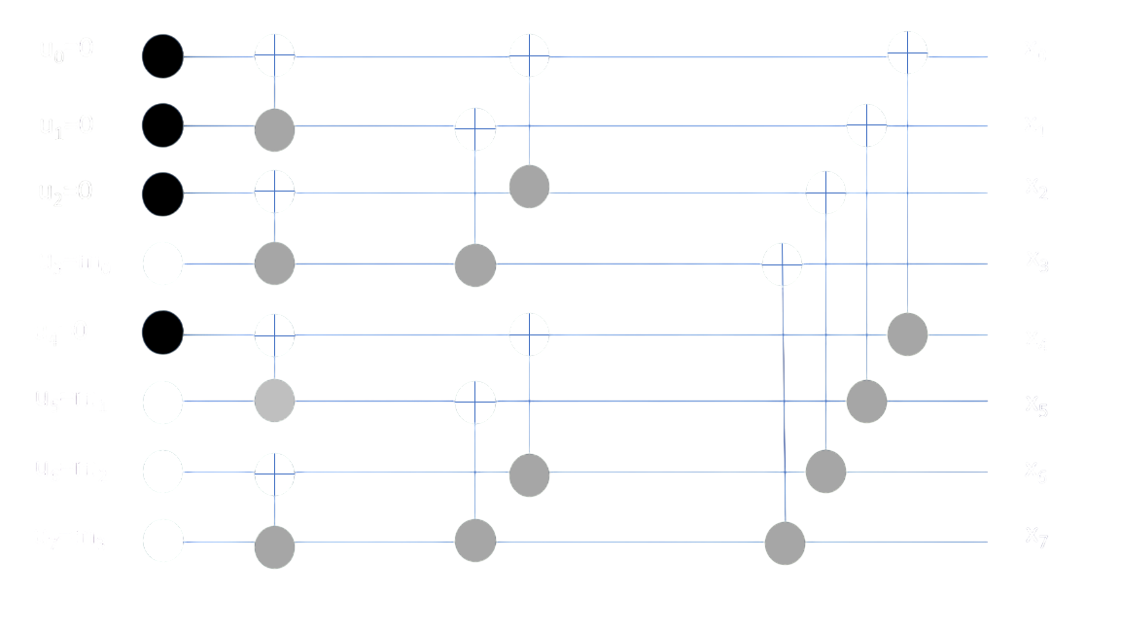
Systematic Encoding of (8,4) Polar code with
Frozen nodes set to “0”

Slide 30
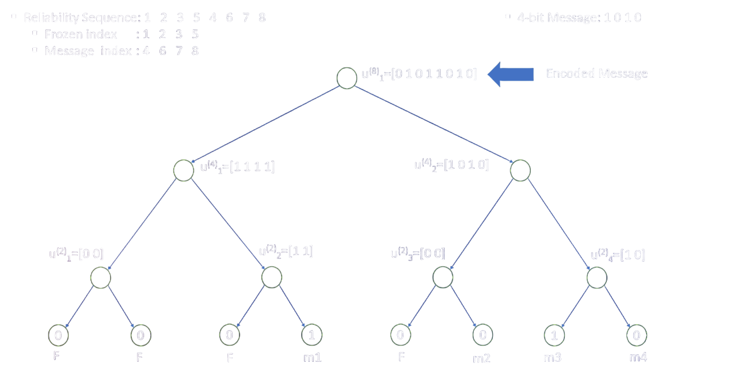
(8,4) Polar Code

Slide 31
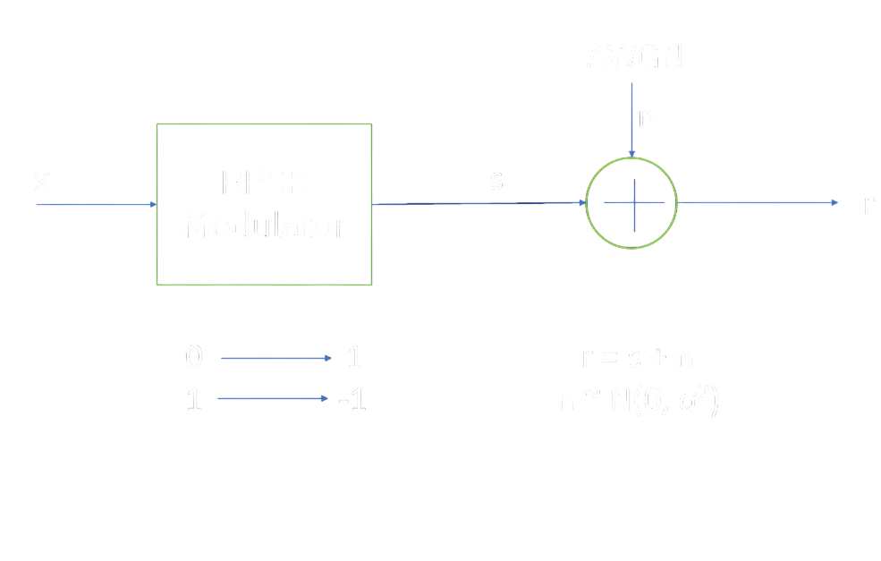
BPSK - AWGN
After Encoding the message bits, we are passing the codeword through BPSK Modulator followed by AWGN Channel.
• Binary Phase Shift Keying (BPSK) is used for transmitting binary data over any communication Channel.
• BPSK is important in communication systems such as Wi-Fi, Bluetooth, and satellite communication.
• It is very simple and reliable, thus making it ideal for applications with suboptimal communication channels too.

Slide 32
BPSK - AWGN
After Encoding the message bits, we are passing the codeword through BPSK Modulator followed by AWGN Channel.
• The Additive White Gaussian Noise (AWGN) channel is a fundamental model used in the analysis and design of communication systems to mimic the effect of many random process that occur in nature.
• It models transmission of signal in presence of additive white gaussian noise, n ~ N(0, σ2).
• The AWGN channel is good model for many satellite and deep space communications links.

Slide 33
Decoding

Slide 34
Decoding
Successive Cancellation
Decoding
Successive Cancellation
List Decoding
(with CRC)

Slide 35
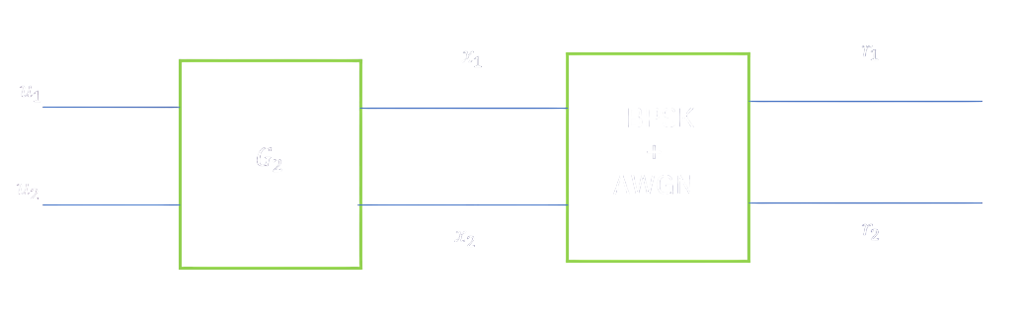
Successive Cancellation
Decoding
BPSK
+
AWGN

Slide 36
Decoding
Hard decision
Converts received signal directly into 0 or 1 by thresholding, ignoring signal confidence level.
Soft decision
Uses the reliability or probability of each bit (like LLRs) to make more informed decoding decisions.
SISO stands for Soft-Input, Soft-Output.
Soft Input values : These are probabilities or likelihoods
(not just 0 or 1).
Soft Output values : It gives probabilities for each bit being 0 or 1, rather than making a hard decision right away.

Slide 37

Successive Cancellation
Decoding
r1 is the belief of x1
BPSK
+
AWGN
r2 is the belief of x2

Slide 38
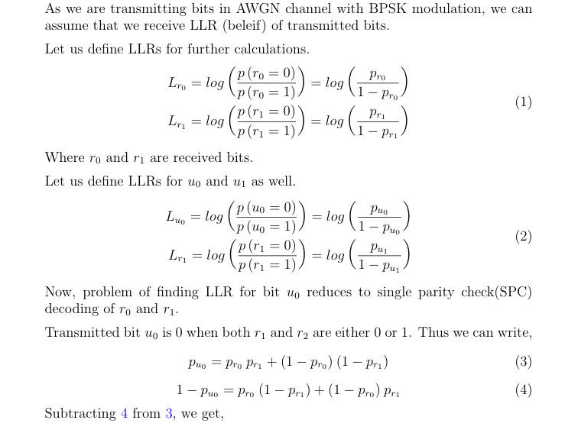
min sum function - derivation

Slide 39
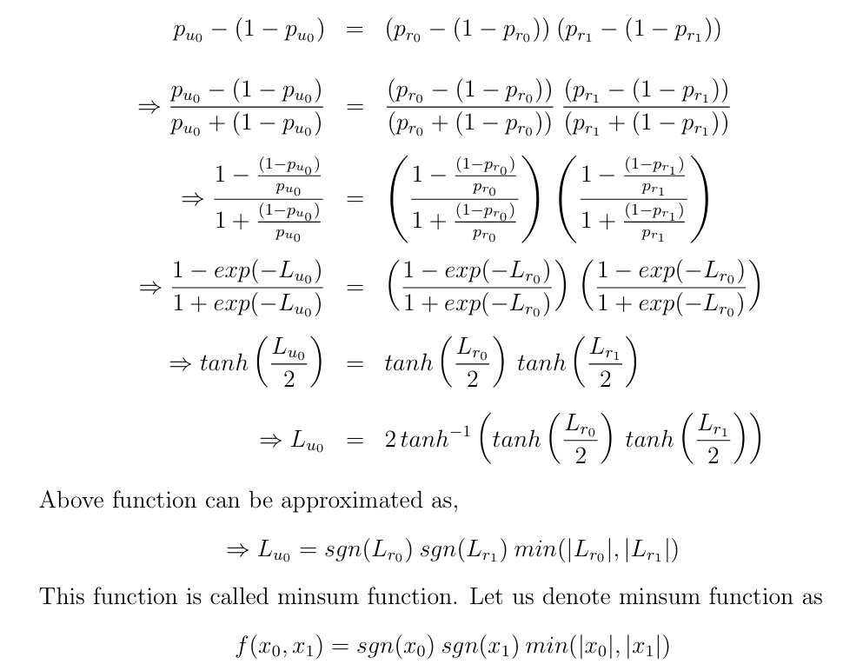
min sum function - derivation

Slide 40
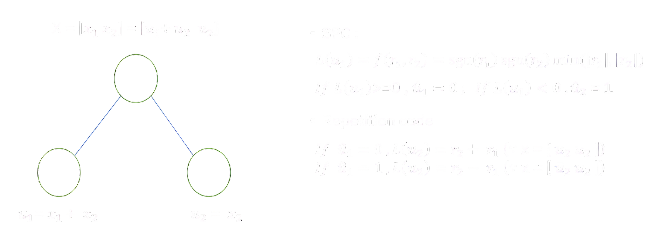
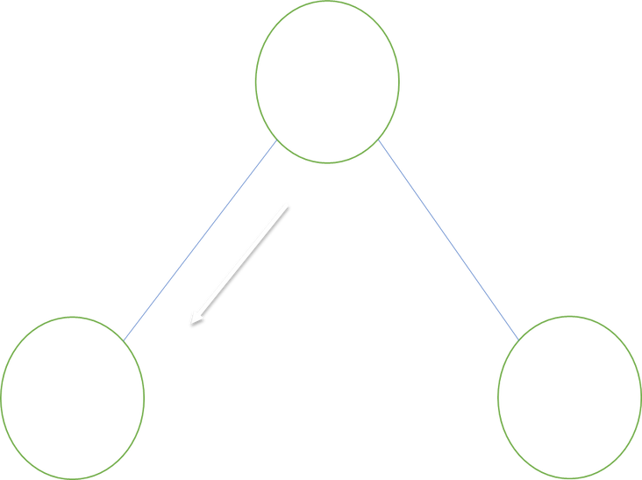
Successive Cancellation
Decoding
Basic Block

Slide 41
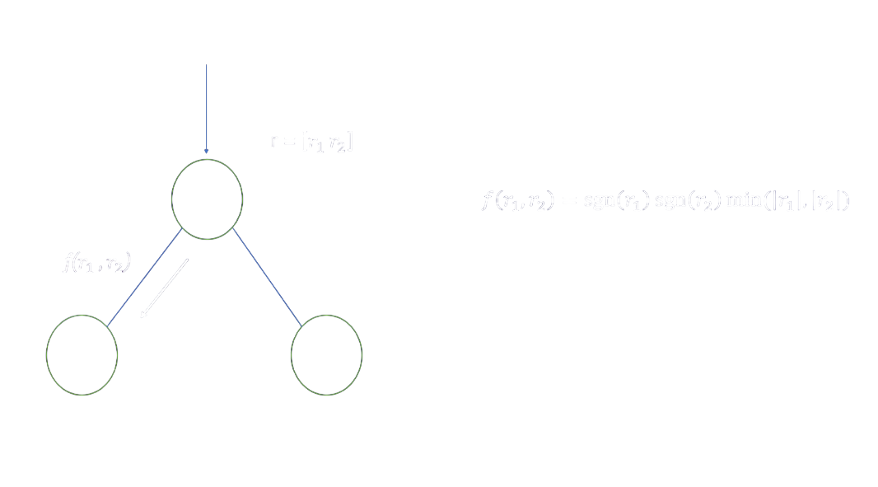

Slide 42
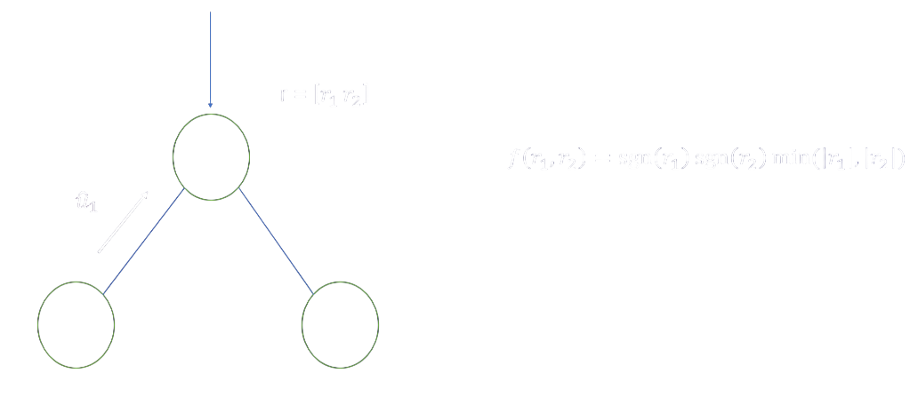

Slide 43
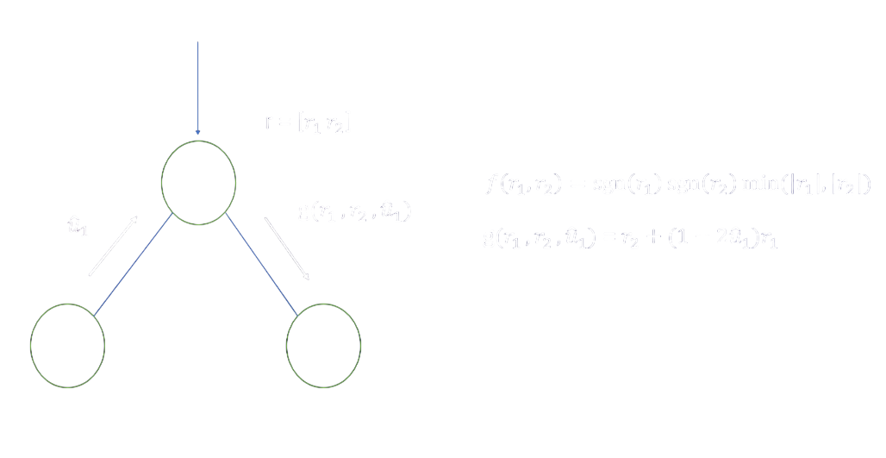

Slide 44
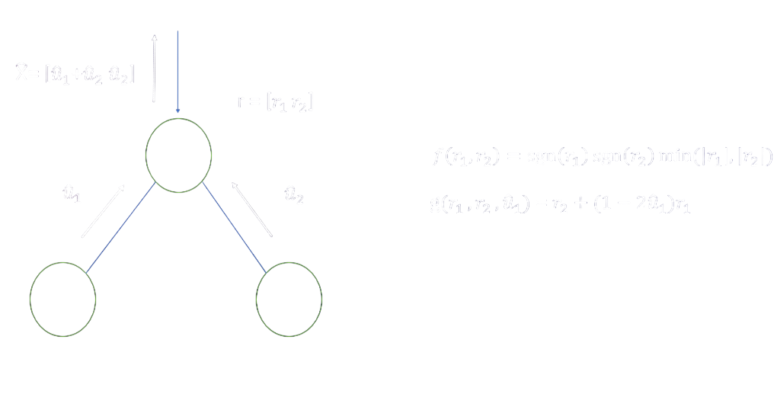

Slide 45
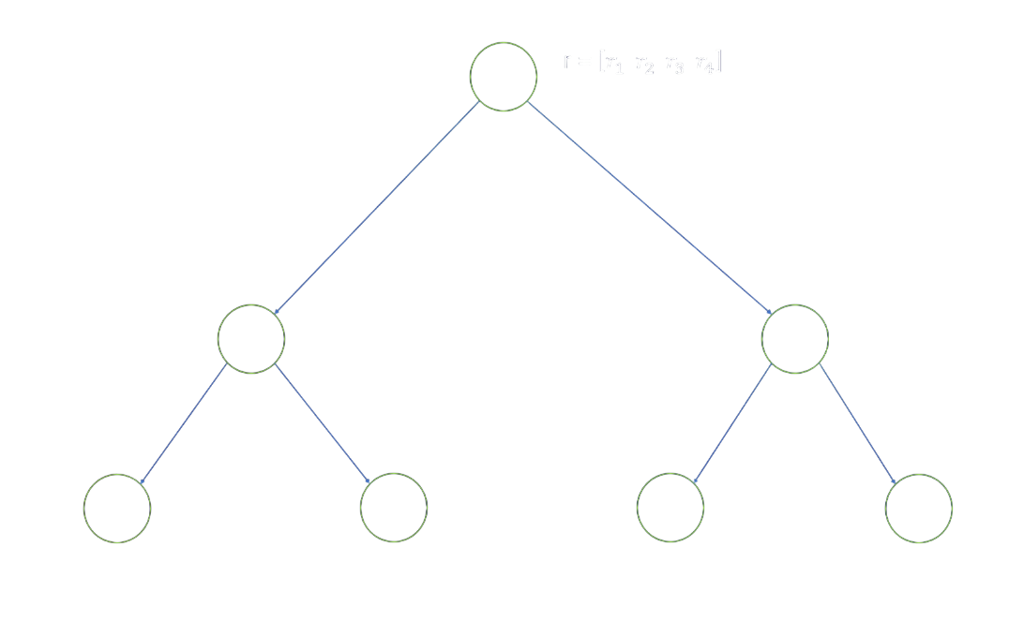

Slide 46
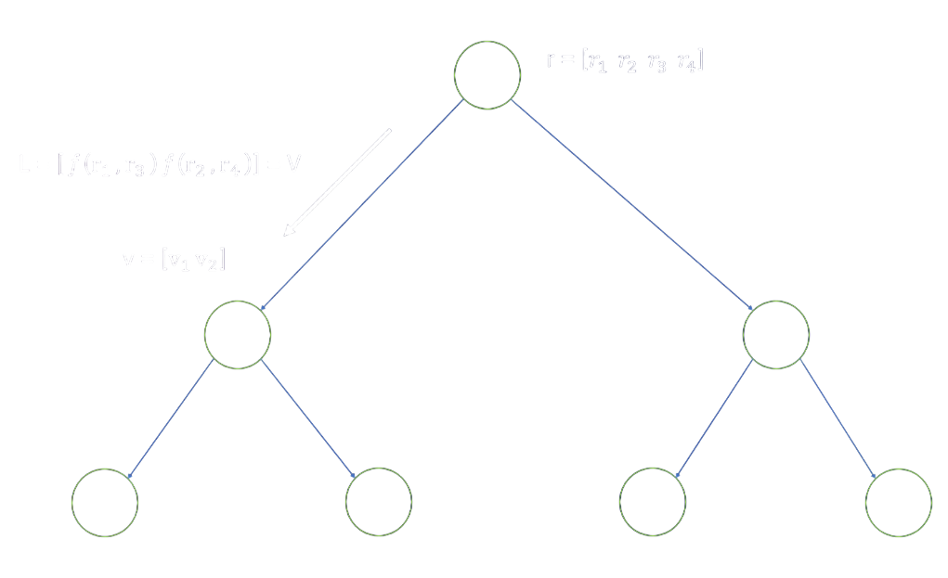
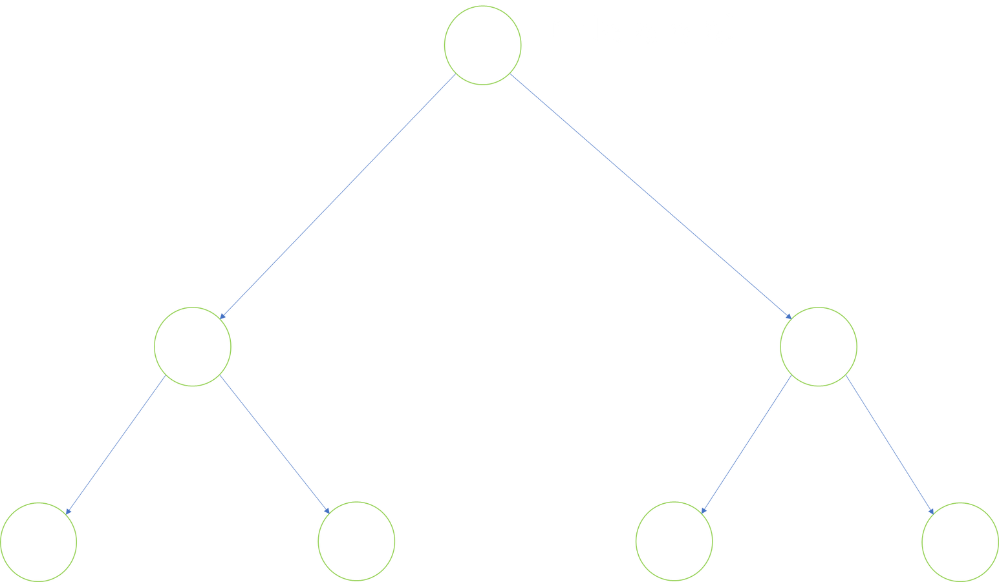

Slide 47
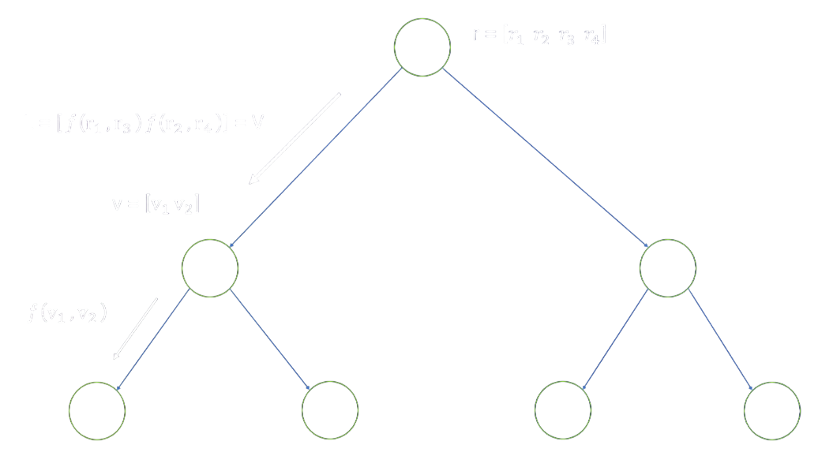

Slide 48
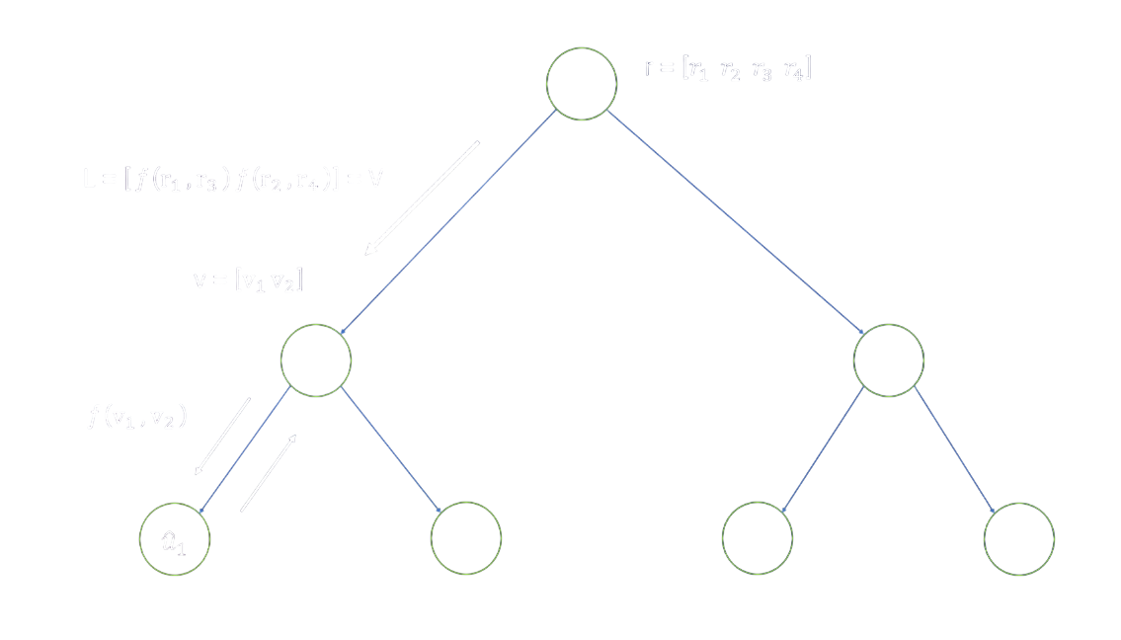

Slide 49
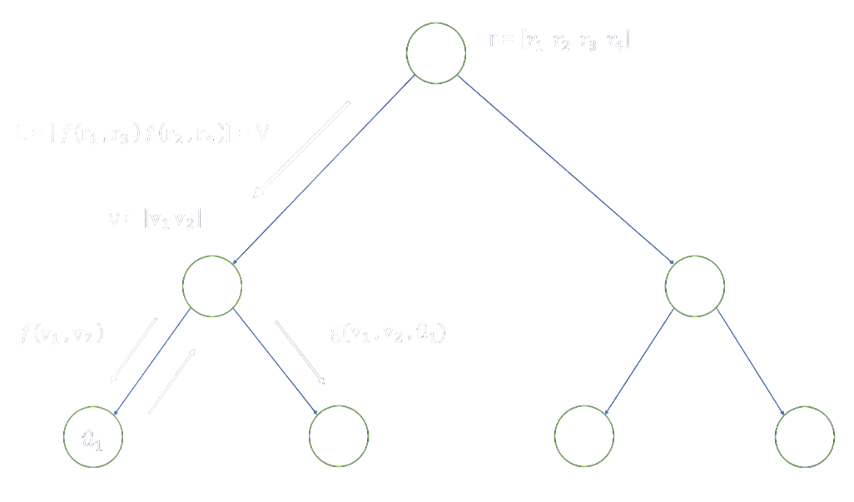

Slide 50
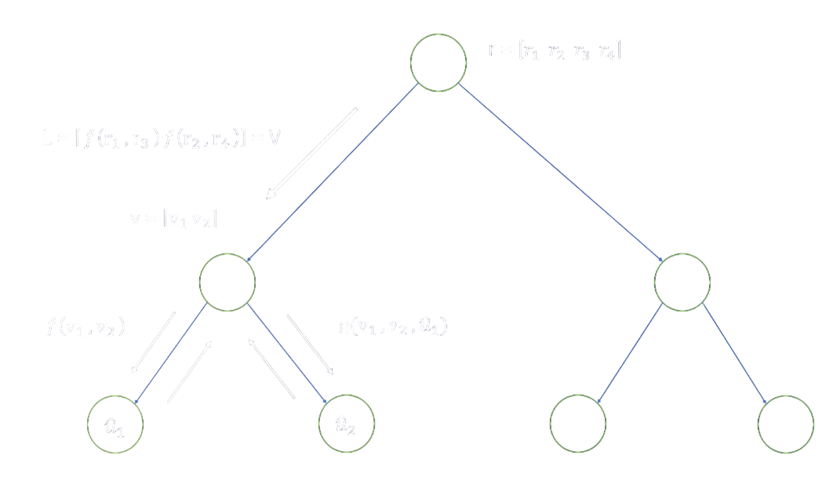

Slide 51
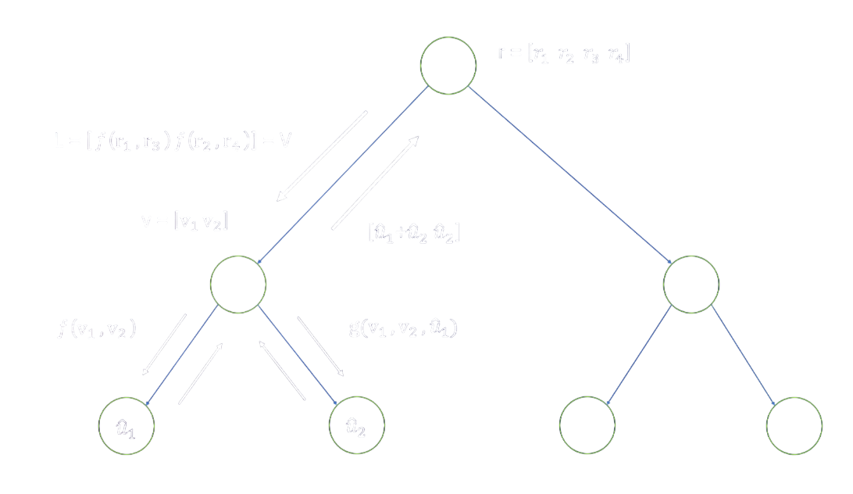

Slide 52
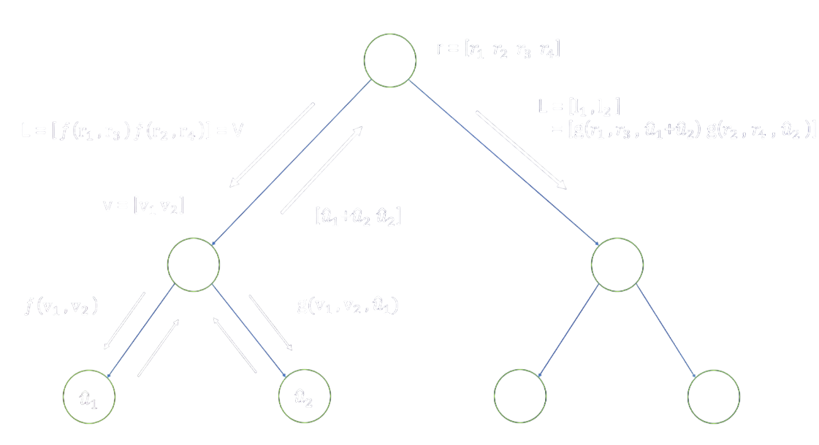

Slide 53
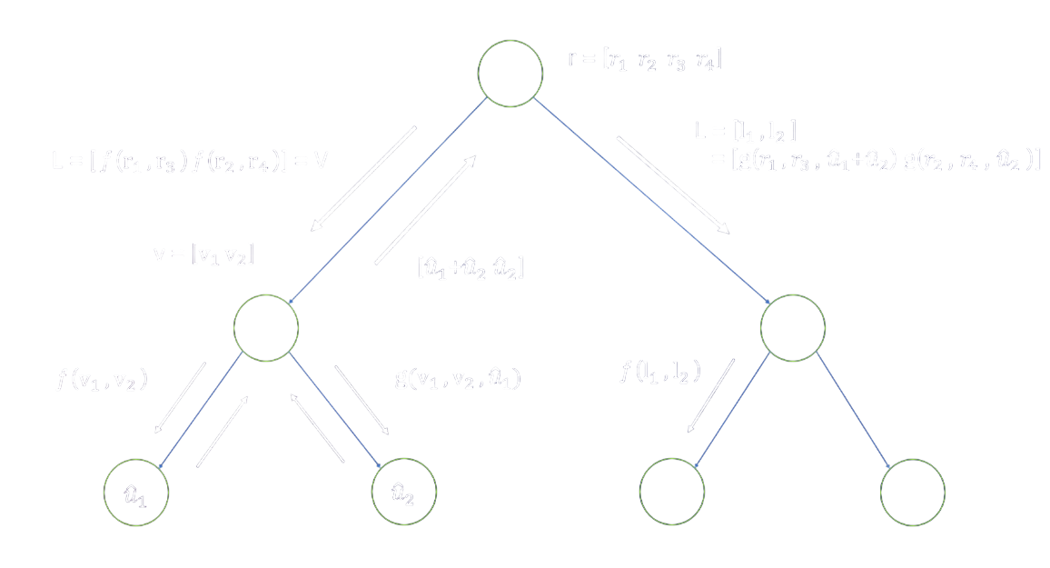

Slide 54
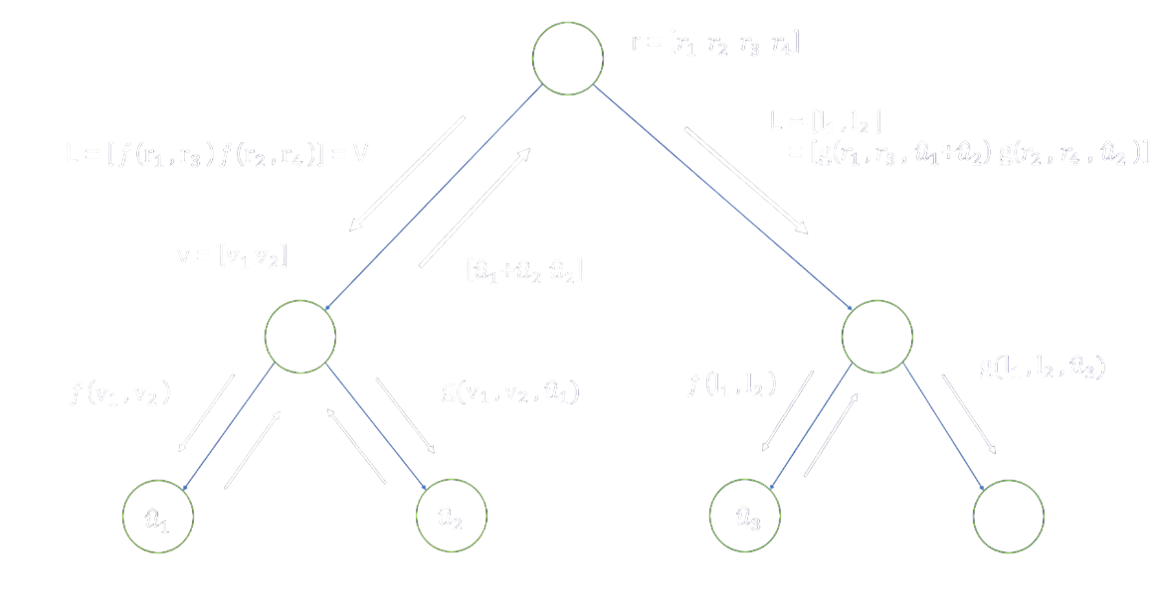

Slide 55
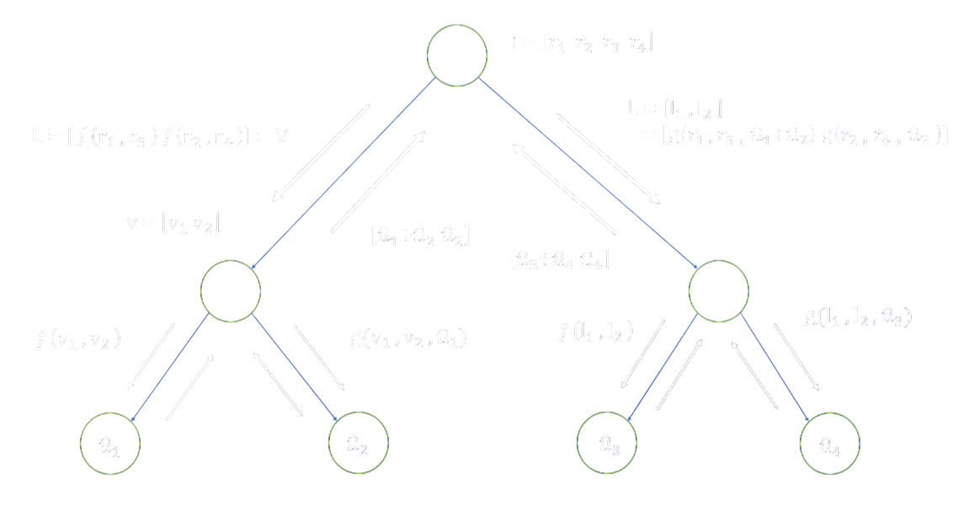

Slide 56
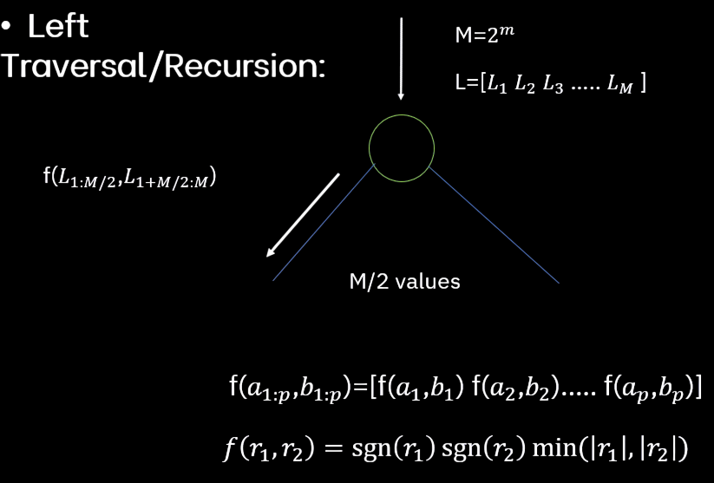
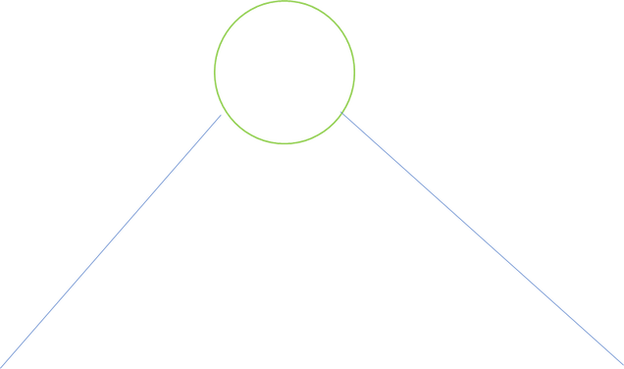

Slide 57
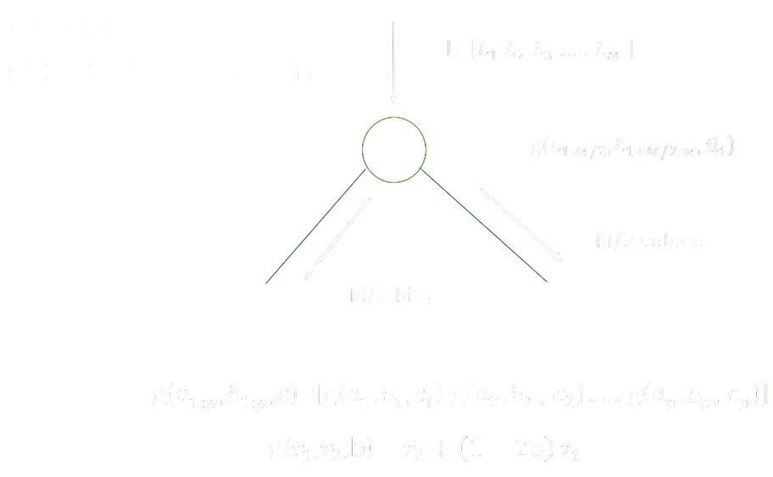

Slide 58
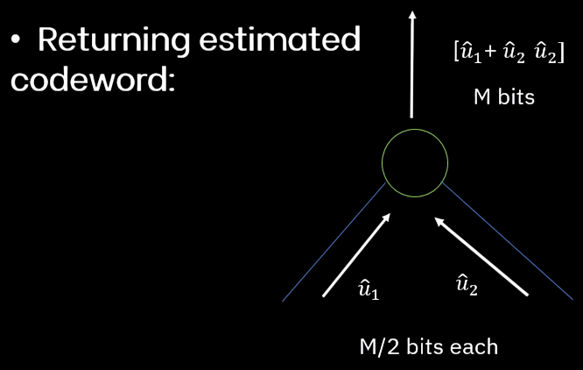

Slide 59
Successive Decoding Limitations & Introduction to SCL Decoding(CRC aided)
The error-correction performance of short polar codes under SC decoding does not satisfy the requirements of the 5G standard.
By keeping a list of Candidate message words at each stage of the decoding process, SC list (SCL) decoding was developed to improve the error-correction performance of SC decoding.
In SCL Decoding when the polar code is concatenated with a cyclic redundancy check (CRC)code, Error Correction performance is significantly improved.

Slide 60
Successive Cancellation List Decoder
Successive Cancellation List (SCL) decoding is an extension of standard decoding methods used in polar codes.
It operates by maintaining a list of potential codewords throughout the decoding process. By exploring multiple paths simultaneously and pruning less promising options, SCL decoding enhances error correction capabilities.
Overall, SCL decoding represents a powerful tool for improving the reliability of communication systems employing polar codes.
One negative Point of SCL Decoder
Decoding Complexity of SCL grows as the list Size increases.

Slide 61
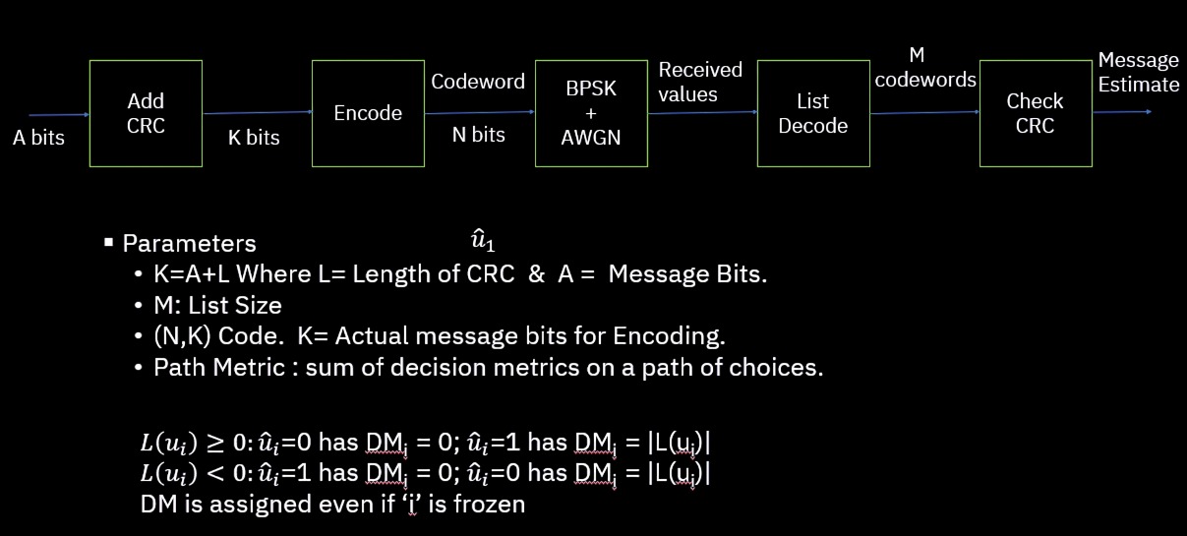
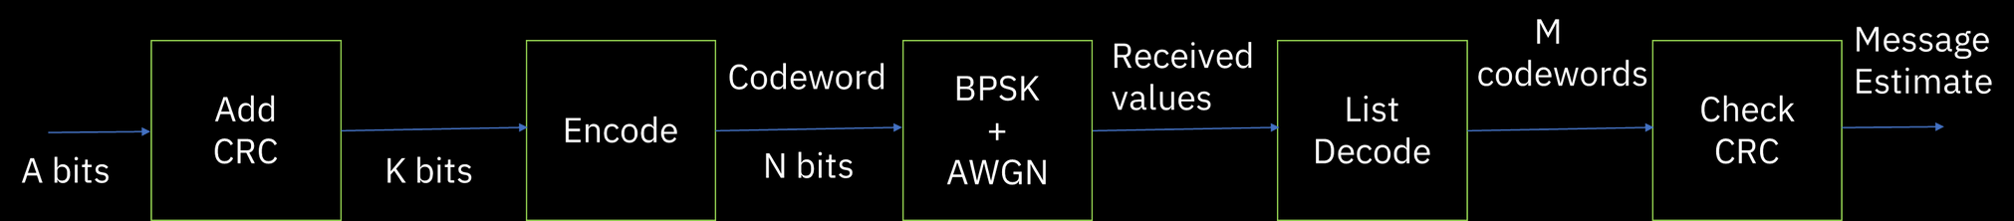
Process of SCL Decoding

Slide 62


Successive Cancellation List Decoder
Considering both the choices at each bit and keeping respective path matrix of L size.

Slide 63

Successive Cancellation List Decoder
For more than L output we keep L best path (L paths with lowest path metrix) at that point. { here L=4 }

Slide 64
CRC check in SCL decoding
CRC-aided SCL decoding is an enhanced version of SCL decoding for polar codes.
It combines two things:
SCL Decoding: Keeps multiple possible decoding paths (list).
CRC (Cyclic Redundancy Check): Helps select the correct path from the list at the end.
Encoding stage:
Add a CRC (e.g. 11-bit) to original message bits.
This CRC is calculated using a generator polynomial.
Decoding stage:
Each of L candidate codeword is checked using the CRC:
Only candidates that pass the CRC check are kept.
If multiple pass, pick the most likely one.
If none pass, pick the one with highest likelihood (fallback).

Slide 65
Polar Coding Complexities List
For Given W , N = 2n , and R < I(W), a Polar Code can be Constructed such That it has
Encoding Complexity ≈ N log(N).
Successive-Cancellation Decoding Complexity ≈ Nlog(N).
List Decoder:
First Produce L candidate decisions Pick the most likely word from the list Complexity O(LN log N).

Slide 66

PERFORMANCE
Analysis

Slide 67


Slide 68

PERFORMANCE - Graph Analysis
N = 1024 A = 500 (SEMILOGY PLOT FOR Nsim=10000)
L=4
Observation
1.High BER at low SNR
At very low Eb/N₀ (below ≈1 dB), the noise dominates the BPSK symbols and the SC decoder’s hard decisions are effectively random, yielding a BER close to 0.5 (i.e., half the bits are in error)
2.Waterfall region (≈2–4 dB)
As Eb/N₀ rises into the 2–4 dB range, the curve plunges sharply—this is the classic “waterfall” behavior where a small SNR gain produces a large BER reduction
3.Error floor onset at high SNR
Beyond about 6 dB, the BER continues to decrease nearly exponentially but begins to approach an “error floor” determined by the finite block length and the limitations of SC decoding
X axis:
Eb/N0 (Bit energy to noise power spectral density ratio, in dB)
Y axis:
BER (Bit Error Rate)
Eb/N0 → Range: 0 to 10 dB in steps of 0.5
For each value we find BER with Nsim=10000 simulations

Slide 69

PERFORMANCE - Graph Analysis
N = 1024 A = 500 (SEMILOGY PLOT FOR Nsim=10000)
L=4
Observation
1.Near‐zero Pc at low Eb/N₀
Pc (the fraction of blocks decoded with zero bit‐errors) is essentially 0 at Eb/N₀ ≤ 1 dB, since almost every 1024‑bit frame contains at least one error under SC decoding
2.Steep rise in the waterfall (1–2 dB)
Around the same 1–2 dB region, Pc climbs rapidly from 0 toward 1. This is because once the BER falls below roughly 10⁻³, a large fraction of 1024‑bit blocks become entirely error‐free
3.Asymptotic Pc ≈ 1 at high SNR
For Eb/N₀ beyond about 2 dB, Pc approaches unity, indicating that almost every transmitted block is decoded perfectly
X axis:
Eb/N0 (Bit energy to noise power spectral density ratio, in dB)
Y axis:
Pc (Probability of Correct Decoding)
Eb/N0 → Range: 0 to 10 dB in steps of 0.5
For each value we find BER with Nsim=10000 simulations

Slide 70
PERFORMANCE
SC list
N = 1024
A = 500
BER simulation
Probability of Decoding Success

Slide 71


PERFORMANCE - with change in rate
N = 512 A = 128 (lower rate)
BER simulation - change
Lower rate ⇒ more redundancy. With A/N slightly smaller in this case, the decoder has more frozen bits for the same N, so it corrects errors more easily. Thus you see the BER curve for this case drop earlier (leftward shift).
Probability of Decoding Success - change
More protection per bit means entire blocks become error‑free at a lower Eb/N₀. The Pc curve for this case rises sooner and more steeply.

Slide 72


PERFORMANCE - with change in list size
List Size = 8 N = 1024 A = 500
BER simulation - change
Larger list ⇒ better path diversity. Doubling L gives the decoder more candidate sequences to choose from before pruning, so it corrects more error patterns. You see the BER curve for Ls=8 shift left.
Probability of Decoding Success - change
With more candidates, the chance that the correct codeword survives to the end increases—so full‑block success happens at lower SNR, and the rise is steeper.

Slide 73

PERFORMANCE - with change in rate

Slide 74


PERFORMANCE for SC
N = 1024
K = 512
(SEMILOGY PLOT FOR Nsim=10000)
BER vs Eb/No
Probability of Decoding Success

Slide 75

PERFORMANCE
SC Vs SCL
Curve Shape
SCL decoder achieves higher success probability at lower Eb/N₀, meaning it performs better under noise.
Low Eb/N₀ Region
SCL already performs far better at low SNR due to its list-based path selection, allowing more accurate decoding.
High Eb/N₀ Region
Both perform well here, but SCL reaches near-perfect decoding earlier.
Threshold SNR
SCL achieves high reliability at much lower SNR, clearly more efficient.

Slide 76


PERFORMANCE - Reference result
comparison with
Normal Aproximation &
Shannon Limit
By implimantation of formulas given

Slide 77
Bibliography
https://ieeexplore.ieee.org/document/4782333
Andrew Thangaraj, ‘LDPC and polar codes in 5g standard’ playlist (youtube) , 2019.
‘Polar codes: Primary concepts and practical decoding algorithms’ published by IEEE authors : Kai Niu, Kai Chen, Jiaru Lin, Q.T. Zhang
https://ece.iisc.ac.in/~pvkece/pdfs/InfoTheoryNotes/Wiley_-_2006_-_Elements_of_Information_Theory_2nd_Ed%20(1).pdf (Chapter 7)
https://biblioteca.sbrt.org.br/articlefile/2910.pdf
https://ieeexplore.ieee.org/stamp/stamp.jsp?tp=&arnumber=6852102&tag=1&tag=1
https://web.stanford.edu/class/ee376a/files/polarcodes.pdf

Slide 78




OUR GROUP :
RUSHI GADHIYA
PARV KHETAVAT
MANAV PATEL
DIPKUMAR ZADAFIYA
VISWA VIGNAN BADDULA
DARSHAN RAMANI
MITWA NINAMA
ARYAN RATHOD
SHREY SHAH
RISHIT RAJ JAIN
202301156
202301157
202301158
202301159
202301160
202301161
202301162
202301164
202301165
202301167

Slide 79

Thank You

